Slide 1
Training and Placement System.
Group : Project Guide:
Hiba Rajguru Prof. Rujata Chaudhari
Saurabh Kolmabkar Prof. Anagha Aher
Omkar Shelar

Slide 2
Introduction
This project aims at developing a online portal for training and placement dept. of the college.
The system is an online application that can be accessed throughout the organization and outside as well with proper login provided.
This system can be used as an application for the TPO of the college to manage the student information with regards to placement.

Slide 3
Problem statement
Manual management of training and placement activities.
Difficult for the training and placement officer for maintaining records.
Verification of student documents is time consuming.
Notifications about upcoming drives, placement procedures or expert talks may or may not reach the students.

Slide 4
Existing System
Circulating process.
Selecting the eligible Students.
Poor Communication

Slide 5
Proposed System
Registration
Sorting Students
Notifying the students
Creating automated drive processes

Slide 6
Project Scope
Automatic evaluation of mock test can be done
Graphical Interface of user can be improved.
Sending notification via SMS can be provided.
Various security protocols can be implemented.
The application can be made more user friendly.

Slide 7
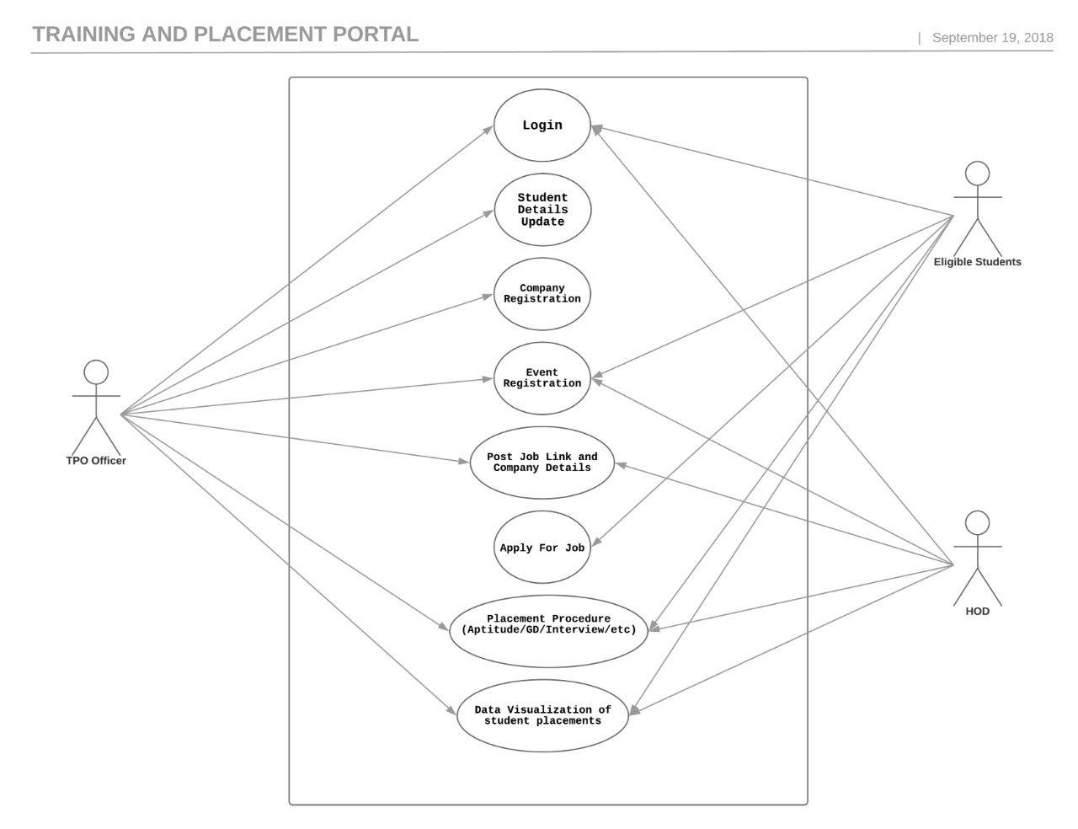
Use case diagram

Slide 8
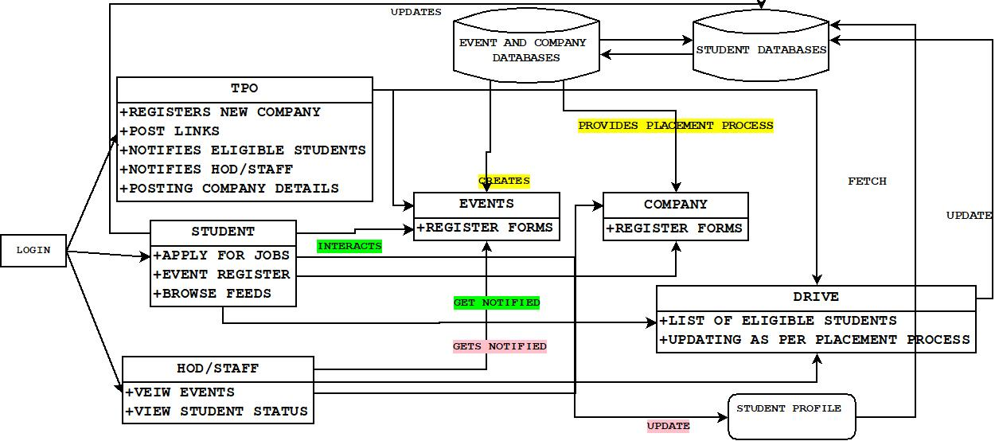
System Architecture

Slide 9
Future Scope
Automated Mock test for evalutions
Android based Application with Notifications
Company login
Data Visualization

Slide 10
Reference
2nd Int'l Conf. on Electrical Engineering and Information & Communication Technology (ICEEICT) 2015 Iahangirnagar University, Dhaka-1342, Bangladesh, 21-23 May 2015
Anjali.V et al, / (IJCSIT) International Journal of Computer Science and Information Technologies, Vol. 7 (2) , 2016, 760-763
Gunderloy, Jorden BPB Publications (2000) - “Mastering SQL Server” 2. Luke Welling and Laura Thomson (5th Edition) - “PHP and MySQL Web Development” 3. Roger S.Pressmen, T. Mc. GH. – Software Engineering (Theoretical Approach) 4. Thereon Willis wrox publications (2000) - “Beginning SQL Server”

